Slide 1

Company Name

Slide 2

Company Purpose

Slide 3
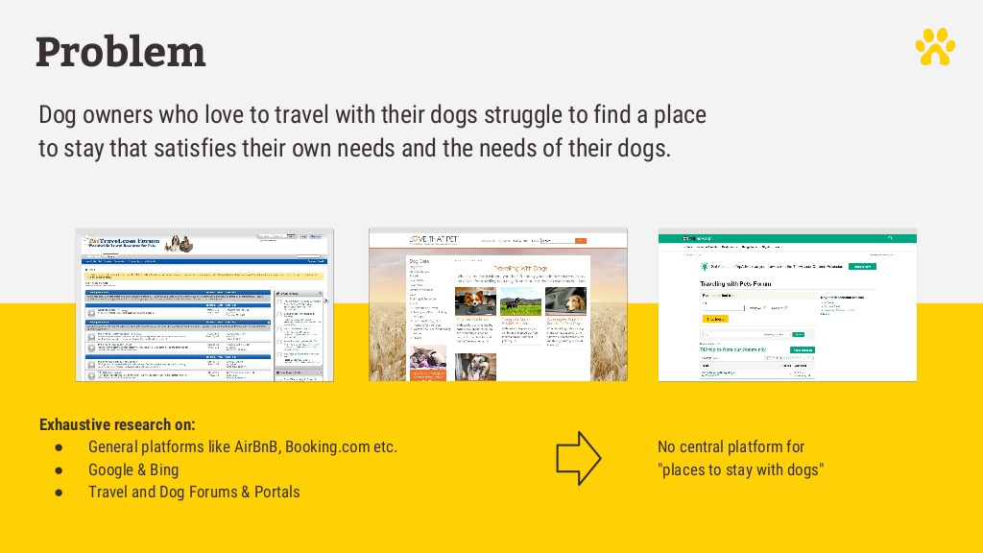
Problem

Slide 4

Solution

Slide 5
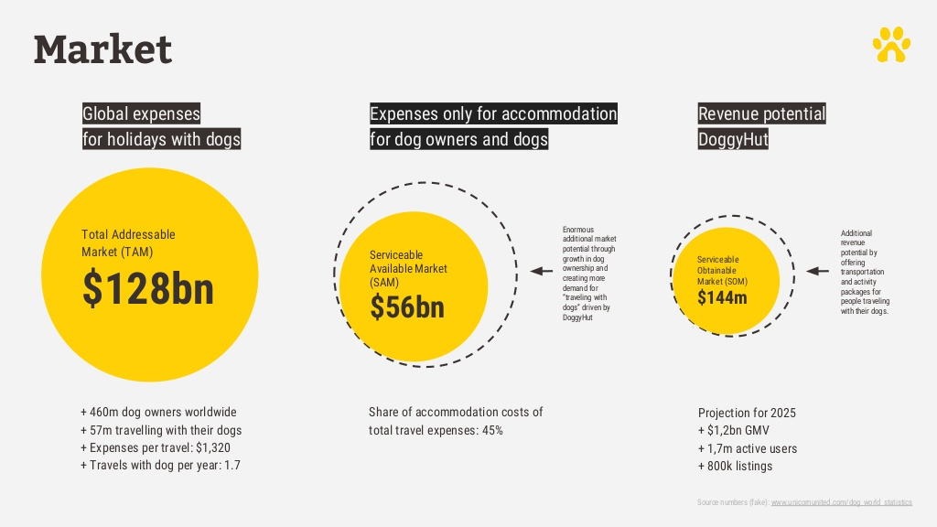
Market

Slide 6

Why Now

Slide 7
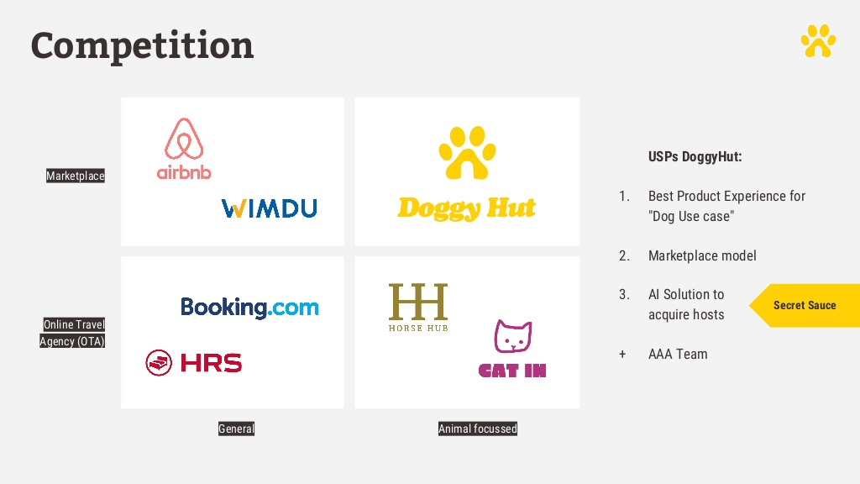
Competition

Slide 8
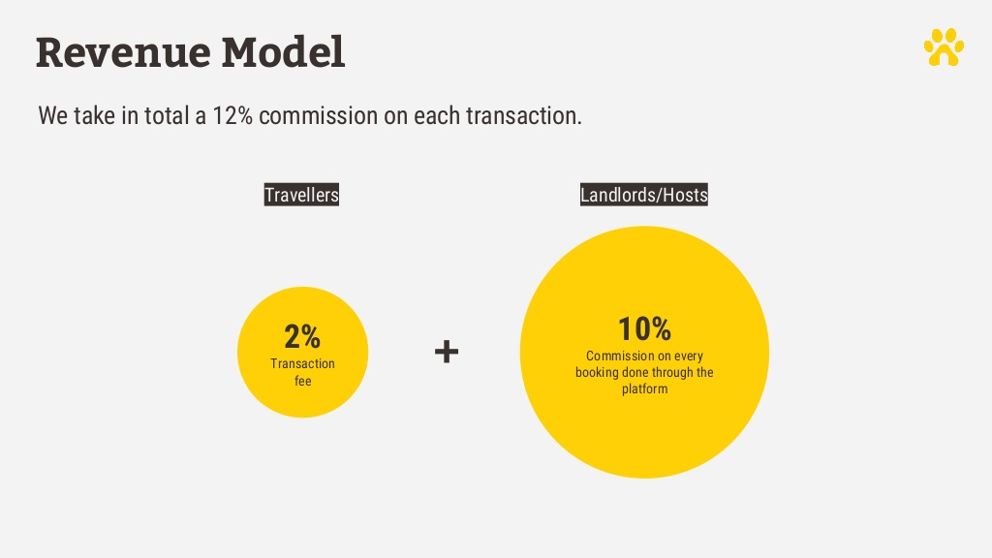
Revenue Model

Slide 9
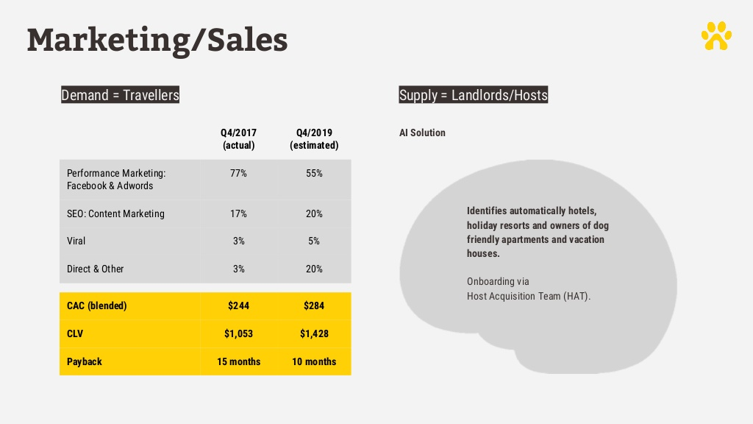
Marketing/Sales

Slide 10
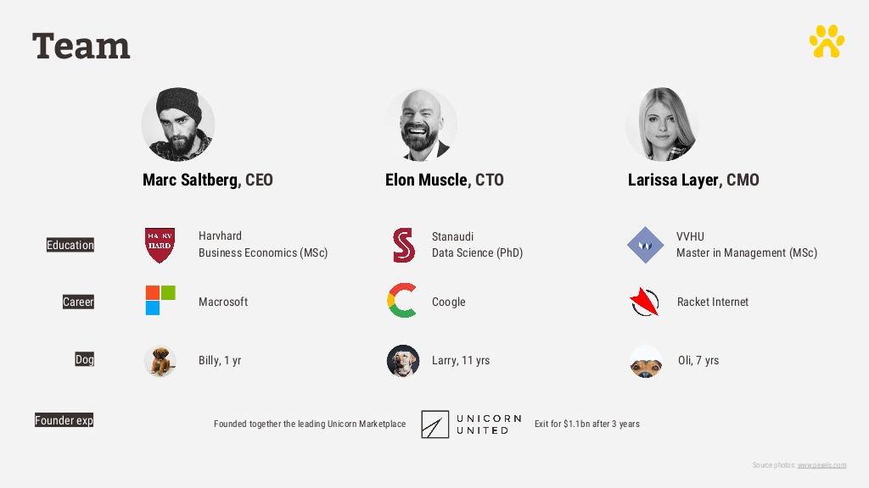
Team

Slide 11
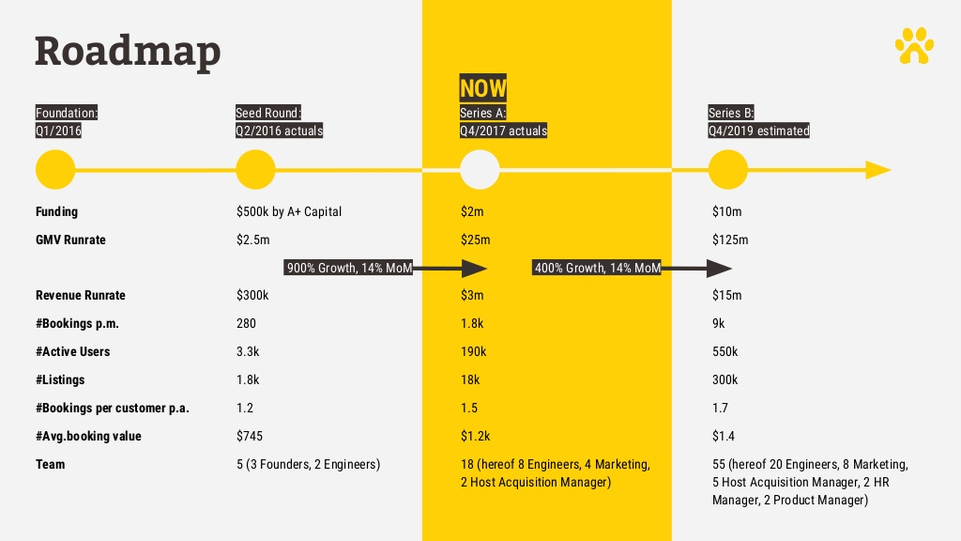
Roadmap

Slide 12

Vision

Slide 13

Contact

